Slide 1
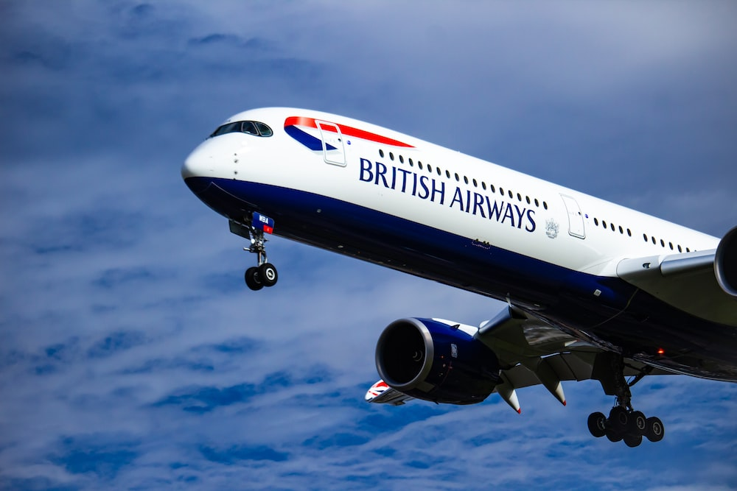
SOLELY FOR PURPOSE OF FORAGE WORK EXPERIENCE
Task 2
Predicting customer buying behavior
Build a predictive model to understand factors that influence buying behaviour
Kamalesh K B
19-06-2023

Slide 2
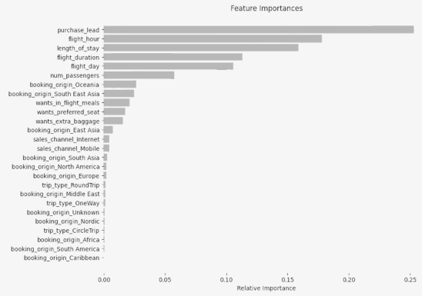
Predictive Model Result
Based on the given problem, a suitable machine learning algorithm to predict customer buying behavior for flights or holidays could be a classification algorithm called Random Forest & The XGBooster Classifier.
From the given dataset field the highly correlated attributes are used to predict the model. They are:
Purchase Lead
Fight Hour
Length of Stay
Fight Duration
Fight Day
Num Passengers
By making use of these attributes the Random Forest & XGBooster model have been successfully build.
Further the model wanted to be optimized to bring out better accuracy predictive model.
Classification | Accuracy Score | F1 - Score
Random Forest | 85.07 | 0.8075
XGBooster | 84.85 | 0.8072

